Slide 1
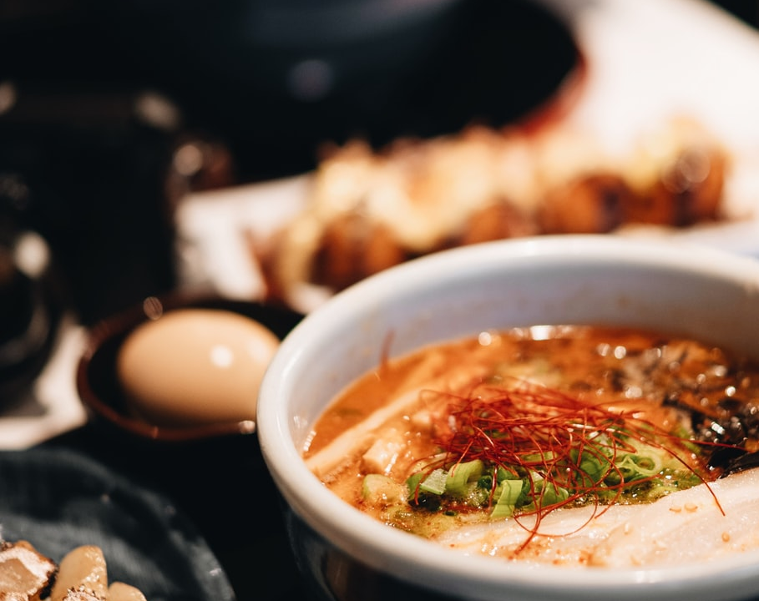
How to get the most bang for your buck in Japan 🍜💹🍣
Joshua Young

Slide 2
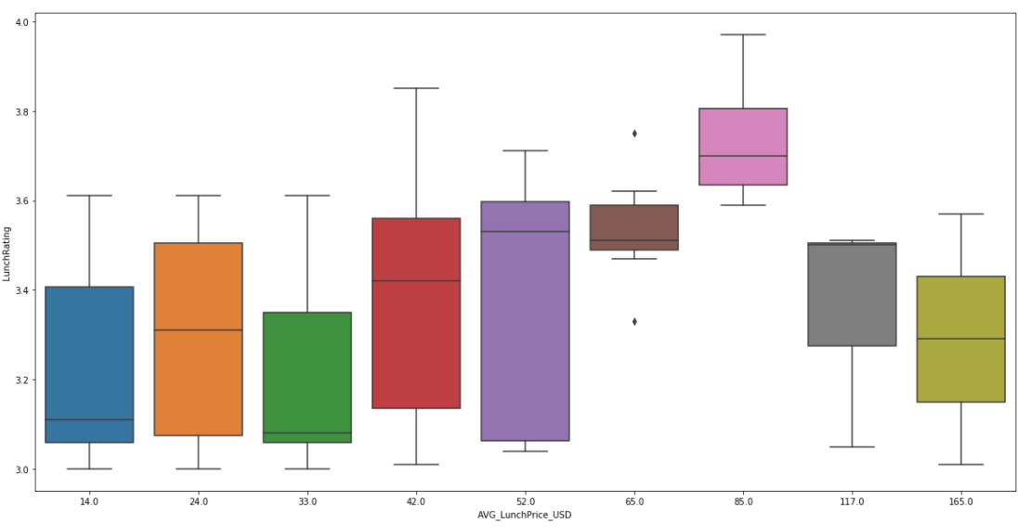
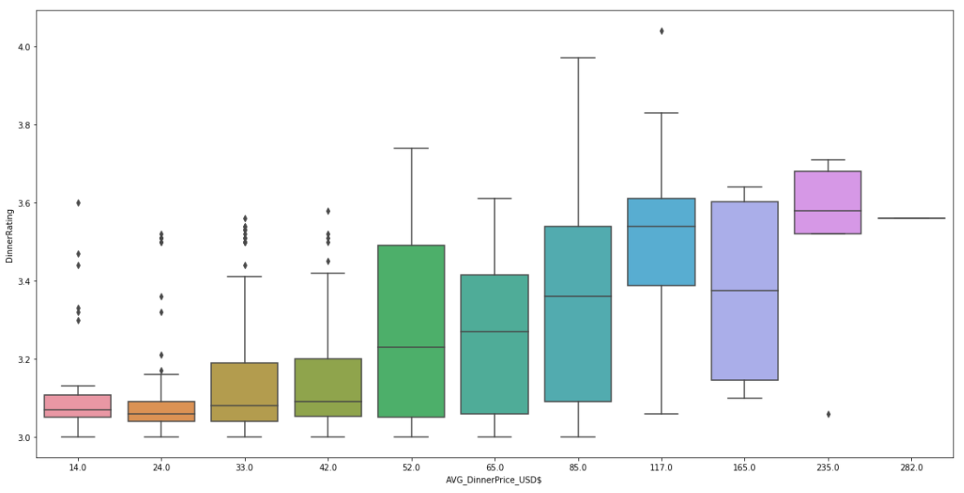
Don’t spend more than $85 on lunch. Spending $235 on dinner is the best guarantee for a meal rating above 3.6
🍜 Lunch: Avg $ for a meal w/ rating
Peak dinning experience for a lunch comes $85 a meal with quality score ranging from 3.6-4.0
That same ticket price for dinner can get you a 4.0 meal but could also get you a 3.0 meal
🍣 Dinner: Avg $ for a meal w/ rating
The more you spend on Dinners the better quality you can anticipate

Slide 3

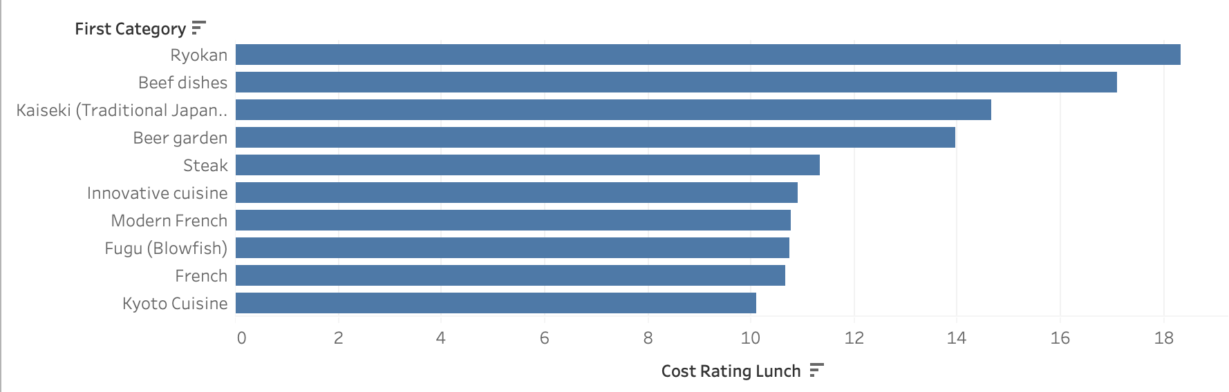
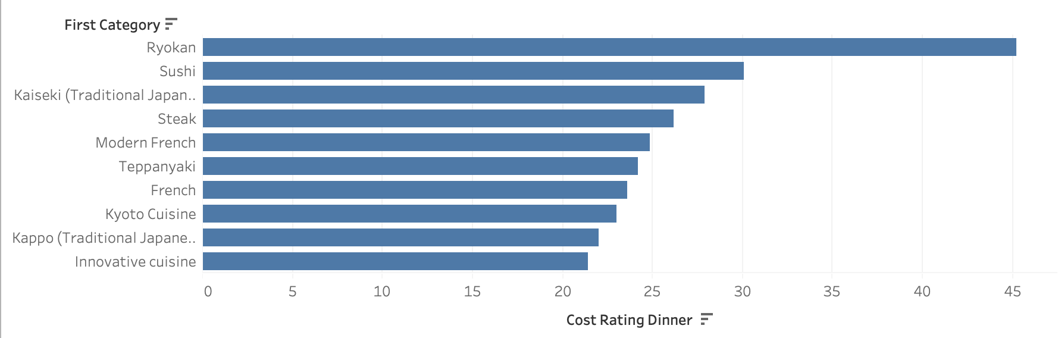
Ryokan restaurants have the best meal for your dollar when comparing price and rating
Top 10 Lunch 🍜 Restaurant Categories
If eating at a Sushi restaurant do so for dinner.
Sushi restaurants comes in number 2 as the best restaurant for the price for dinners but does not even rank in the top ten lunch restaurants.
If eating at a Blowfish restaurant do it during lunch.
Fugu (Blowfish) restaurants make it in the top ten in lunch but not in dinner.
Top 10 Dinner 🍣 Restaurant Categories
*Cost ratings calculated by dividing meal price with meal rating.

Slide 4
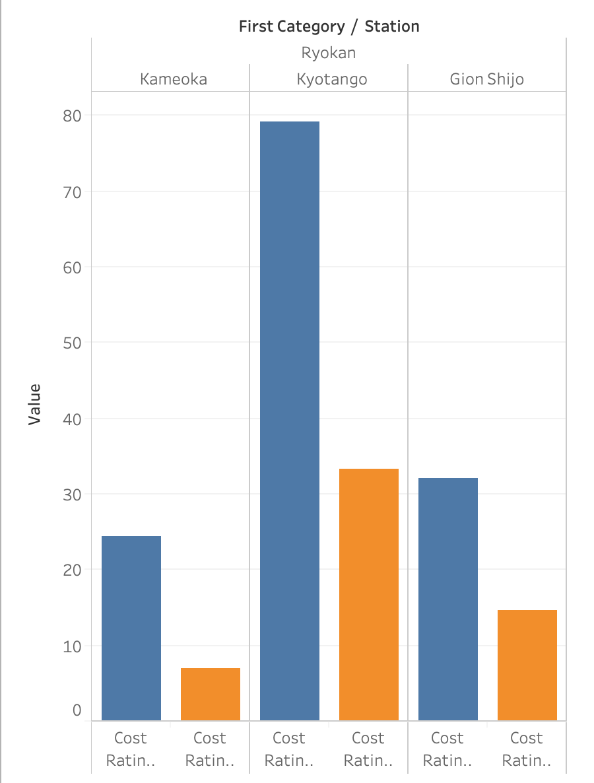
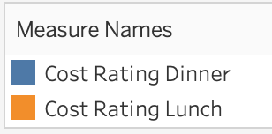
Kyotango prefecture has the highest rated Ryokan restaurants
A Kyotango lunch should be just as good as a Gino Shijo Dinner
The worst bang for your buck for a Ryokan restaurant would be having a Kameoka lunch
🍣
🍜

Slide 5
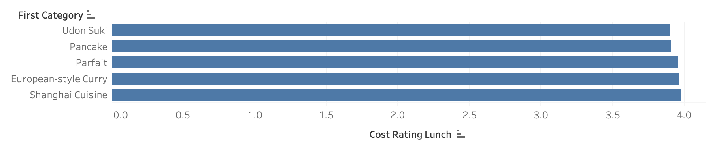
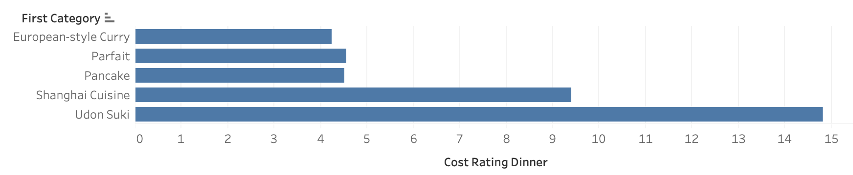
Don’t go to Japan and get European style Curry 🏰🍛😥
Bottom 5 worst Lunch 🍜 Restaurant Categories
Bottom 5 worst Dinner 🍱 Restaurant Categories

